Slide 1
Problem Solving
Russell and Norvig: Chapter 3

Slide 2
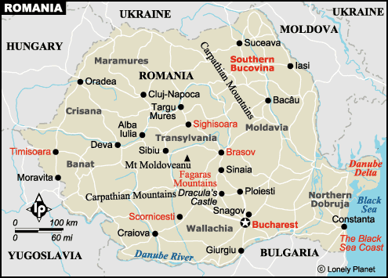

Slide 3
Problem-Solving Agent
sensors
?
environment
agent
actuators

Slide 4
Problem-Solving Agent
sensors
?
environment
agent
actuators
Formulate Goal
Formulate Problem
States
Actions
Find Solution

Slide 5
Example: Route finding

Slide 6
Holiday Planning
On holiday in Romania; Currently in Arad. Flight leaves tomorrow from Bucharest.
Formulate Goal:
Be in Bucharest
Formulate Problem:
States: various cities
Actions: drive between cities
Find solution:
Sequence of cities: Arad, Sibiu, Fagaras, Bucharest

Slide 7
Problem Formulation
States
Actions
Start
Solution
Goal

Slide 8
Single-state problem formulation

Slide 9
Selecting a state space

Slide 10
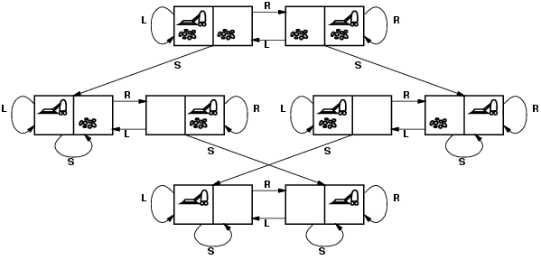
Vacuum world state space graph
states?
actions?
goal test?
path cost?

Slide 11
Vacuum world state space graph
states? integer dirt and robot location
actions? Left, Right, Suck
goal test? no dirt at all locations
path cost? 1 per action

Slide 12
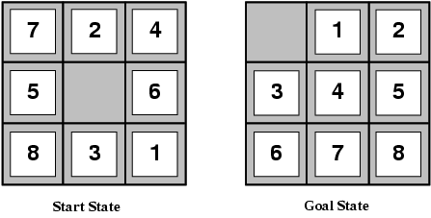
Example: The 8-puzzle
states?
actions?
goal test?
path cost?

Slide 13
Example: The 8-puzzle
states? locations of tiles
actions? move blank left, right, up, down
goal test? = goal state (given)
path cost? 1 per move
[Note: optimal solution of n-Puzzle family is NP-hard]

Slide 14
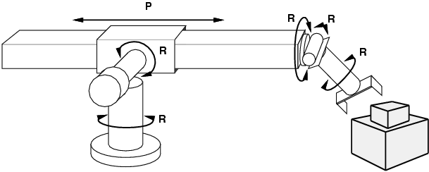
Example: robotic assembly
states?: real-valued coordinates of robot joint angles parts of the object to be assembled actions?: continuous motions of robot joints goal test?: complete assembly path cost?: time to execute

Slide 15
Vacuum World

Slide 16
Search Problem
State space
each state is an abstract representation of the environment
the state space is discrete
Initial state
Successor function
Goal test
Path cost

Slide 17
Search Problem
State space
Initial state:
usually the current state
sometimes one or several hypothetical states (“what if …”)
Successor function
Goal test
Path cost

Slide 18
Search Problem
State space
Initial state
Successor function:
[state → subset of states]
an abstract representation of the possible actions
Goal test
Path cost

Slide 19
Search Problem
State space
Initial state
Successor function
Goal test:
usually a condition
sometimes the description of a state
Path cost

Slide 20
Search Problem
State space
Initial state
Successor function
Goal test
Path cost:
[path → positive number]
usually, path cost = sum of step costs
e.g., number of moves of the empty tile

Slide 21
Example: 8-puzzle
8
2
1
2
3
3
4
7
4
5
6
5
1
6
7
8
Initial state
Goal state

Slide 22
Example: 8-puzzle
8
2
7
3
4
8
2
5
1
6
3
4
7
5
1
6
8
2
8
2
3
4
7
3
4
7
5
1
6
5
1
6

Slide 23
Example: 8-puzzle
Size of the state space = 9!/2 = 181,440
15-puzzle → .65 x 10¹²
24-puzzle → .5 x 10²⁵
0.18 sec
6 days
12 billion years
10 million states/sec

Slide 24
Example: 8-queens
Place 8 queens in a chessboard so that no two queens are in the same row, column, or diagonal.
A solution
Not a solution

Slide 25
Example: 8-queens
Formulation #1:
States: any arrangement of
0 to 8 queens on the board
Initial state: 0 queens on the
board
Successor function: add a
queen in any square
Goal test: 8 queens on the
board, none attacked
→ 64⁸ states with 8 queens

Slide 26
Example: 8-queens
Formulation #2:
States: any arrangement of
k = 0 to 8 queens in the k
leftmost columns with none
attacked
Initial state: 0 queens on the
board
Successor function: add a
queen to any square in the leftmost empty column such that it is not attacked
by any other queen
Goal test: 8 queens on the
board
→ 2,067 states

Slide 27
Example: Robot navigation
What is the state space?

Slide 28
Example: Robot navigation
Cost of one horizontal/vertical step = 1
Cost of one diagonal step = √2

Slide 29
Example: Robot navigation

Slide 30
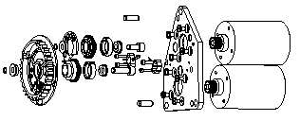
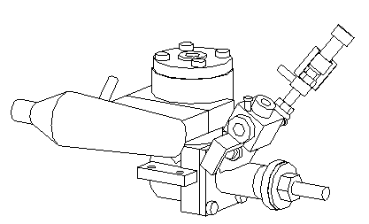

Example: Assembly Planning
Initial state
Complex function:
it must find if a collision-free
merging motion exists
Goal state
Successor function:
Merge two subassemblies

Slide 31
Example: Assembly Planning

Slide 32
Example: Assembly Planning

Slide 33
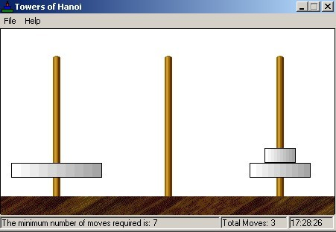
Towers Of Hanoi Problem
A
B
C
1
3
2

Slide 34
Assumptions in Basic Search
The environment is static
The environment is discretizable
The environment is observable
The actions are deterministic

Slide 35
Simple Agent Algorithm
Problem-Solving-Agent
initial-state ← sense/read state
goal ← select/read goal
successor ← select/read action models
problem ← (initial-state, goal, successor)
solution ← search(problem)
perform(solution)

Slide 36
Search of State Space

Slide 37
Search of State Space

Slide 38
Search State Space

Slide 39
Search of State Space

Slide 40
Search of State Space

Slide 41
Search of State Space
→ search tree

Slide 42
Basic Search Concepts
Search tree
Search node
Node expansion
Search strategy: At each stage it determines which node to expand

Slide 43
Search Nodes ≠ States
8
2
3
4
7
5
1
6
8
2
7
The search tree may be infinite even
when the state space is finite
3
4
5
1
6
8
2
8
2
8
4
2
8
2
3
4
7
3
4
7
3
7
3
4
7
5
1
6
5
1
6
5
1
6
5
1
6

Slide 44
Node Data Structure
STATE
PARENT
ACTION
COST
DEPTH
If a state is too large, it may
be preferable to only represent the
initial state and (re-)generate the
other states when needed

Slide 45
Fringe
Set of search nodes that have not been expanded yet
Implemented as a queue FRINGE
INSERT(node,FRINGE)
REMOVE(FRINGE)
The ordering of the nodes in FRINGE defines the search strategy

Slide 46
Search Algorithm
If GOAL?(initial-state) then return initial-state
INSERT(initial-node,FRINGE)
Repeat:
If FRINGE is empty then return failure
n ← REMOVE(FRINGE)
s ← STATE(n)
For every state s’ in SUCCESSORS(s)
Create a node n’
If GOAL?(s’) then return path or goal state
INSERT(n’,FRINGE)

Slide 47
Search Strategies
A strategy is defined by picking the order of node expansion
Performance Measures:
Completeness – does it always find a solution if one exists?
Time complexity – number of nodes generated/expanded
Space complexity – maximum number of nodes in memory
Optimality – does it always find a least-cost solution
Time and space complexity are measured in terms of
b – maximum branching factor of the search tree
d – depth of the least-cost solution
m – maximum depth of the state space (may be ∞)

Slide 48
b =
d =
m =
Start Node

Slide 49
Remark
Some problems formulated as search problems are NP-hard problems. We cannot expect to solve such a problem in less than exponential time in the worst-case
But we can nevertheless strive to solve as many instances of the problem as possible

Slide 50
Blind vs. Heuristic Strategies
Blind (or uninformed) strategies do not exploit any of the information contained in a state
Heuristic (or informed) strategies exploits such information to assess that one node is “more promising” than another

Slide 51
Blind Search…
…[the ant] knew that a certain arrangement had to be made, but it could not figure out how to make it. It was like a man with a tea-cup in one hand and a sandwich in the other, who wants to light a cigarette with a match. But, where the man would invent the idea of putting down the cup and sandwich—before picking up the cigarette and the match—this ant would have put down the sandwich and picked up the match, then it would have been down with the match and up with the cigarette, then down with the cigarette and up with the sandwich, then down with the cup and up with the cigarette, until finally it had put down the sandwich and picked up the match. It was inclined to rely on a series of accidents to achieve its object. It was patient and did not think… Wart watched the arrangements with a surprise which turned into vexation and then into dislike. He felt like asking why it did not think things out in advance… T.H. White, The Once and Future King

Slide 52
Blind Strategies
Breadth-first
Bidirectional
Depth-first
Depth-limited
Iterative deepening
Uniform-Cost
Step cost = 1
Step cost = c(action)
≥ ε > 0

Slide 53
Breadth-First Strategy
New nodes are inserted at the end of FRINGE
1
2
3
FRINGE = (1)
4
5
6
7

Slide 54
Breadth-First Strategy
New nodes are inserted at the end of FRINGE
1
2
3
FRINGE = (2, 3)
4
5
6
7

Slide 55
Breadth-First Strategy
New nodes are inserted at the end of FRINGE
1
2
3
FRINGE = (3, 4, 5)
4
5
6
7

Slide 56
Breadth-First Strategy
New nodes are inserted at the end of FRINGE
1
2
3
FRINGE = (4, 5, 6, 7)
4
5
6
7

Slide 57
Evaluation
b: branching factor
d: depth of shallowest goal node
Complete
Optimal if step cost is 1
Number of nodes generated: 1 + b + b² + … + b^{d} + b(b^{d}-1) = O(b^{d+1})
Time and space complexity is O(b^{d+1})

Slide 58
Time and Memory Requirements
d | #Nodes | Time | Memory
2 | 111 | .01 msec | 11 Kbytes
4 | 11,111 | 1 msec | 1 Mbyte
6 | ~10⁶ | 1 sec | 100 Mb
8 | ~10⁸ | 100 sec | 10 Gbytes
10 | ~10¹⁰ | 2.8 hours | 1 Tbyte
12 | ~10¹² | 11.6 days | 100 Tbytes
14 | ~10¹⁴ | 3.2 years | 10,000 Tb
Assumptions: b = 10; 1,000,000 nodes/sec; 100bytes/node
Notes:
Note that this table is for different assumptions that the one in R&N

Slide 59
Time and Memory Requirements
d | #Nodes | Time | Memory
2 | 111 | .01 msec | 11 Kbytes
4 | 11,111 | 1 msec | 1 Mbyte
6 | ~10⁶ | 1 sec | 100 Mb
8 | ~10⁸ | 100 sec | 10 Gbytes
10 | ~10¹⁰ | 2.8 hours | 1 Tbyte
12 | ~10¹² | 11.6 days | 100 Tbytes
14 | ~10¹⁴ | 3.2 years | 10,000 Tb
Assumptions: b = 10; 1,000,000 nodes/sec; 100bytes/node

Slide 60
Bidirectional Strategy
2 fringe queues: FRINGE1 and FRINGE2
Time and space complexity = O(b^{d/2}) << O(b^{d})

Slide 61
Depth-First Strategy
New nodes are inserted at the front of FRINGE
1
2
3
FRINGE = (1)
4
5

Slide 62
Depth-First Strategy
New nodes are inserted at the front of FRINGE
1
2
3
FRINGE = (2, 3)
4
5

Slide 63
Depth-First Strategy
New nodes are inserted at the front of FRINGE
1
2
3
FRINGE = (4, 5, 3)
4
5

Slide 64
Depth-First Strategy
New nodes are inserted at the front of FRINGE
1
2
3
4
5

Slide 65
Depth-First Strategy
New nodes are inserted at the front of FRINGE
1
2
3
4
5

Slide 66
Depth-First Strategy
New nodes are inserted at the front of FRINGE
1
2
3
4
5

Slide 67
Depth-First Strategy
New nodes are inserted at the front of FRINGE
1
2
3
4
5

Slide 68
Depth-First Strategy
New nodes are inserted at the front of FRINGE
1
2
3
4
5

Slide 69
Depth-First Strategy
New nodes are inserted at the front of FRINGE
1
2
3
4
5

Slide 70
Depth-First Strategy
New nodes are inserted at the front of FRINGE
1
2
3
4
5

Slide 71
Depth-First Strategy
New nodes are inserted at the front of FRINGE
1
2
3
4
5

Slide 72
Evaluation
b: branching factor
d: depth of shallowest goal node
m: maximal depth of a leaf node
Complete only for finite search tree
Not optimal
Number of nodes generated: 1 + b + b² + … + b^{m} = O(b^{m})
Time complexity is O(b^{m})
Space complexity is O(bm)

Slide 73
Depth-Limited Strategy
Depth-first with depth cutoff k (maximal depth below which nodes are not expanded)
Three possible outcomes:
Solution
Failure (no solution)
Cutoff (no solution within cutoff)

Slide 74
Iterative Deepening Strategy
Repeat for k = 0, 1, 2, …:
Perform depth-first with depth cutoff k
Complete
Optimal if step cost =1
Time complexity is: (d+1)(1) + db + (d-1)b² + … + (1) b^{d} = O(b^{d})
Space complexity is: O(bd)

Slide 75
Comparison of Strategies
Breadth-first is complete and optimal, but has high space complexity
Depth-first is space efficient, but neither complete nor optimal
Iterative deepening is asymptotically optimal

Slide 76
Repeated States
No
Few
Many
1
2
3
search tree is finite
search tree is infinite
4
5
7
8
6
8-queens
assembly planning
8-puzzle and robot navigation

Slide 77
Avoiding Repeated States
Requires comparing state descriptions
Breadth-first strategy:
Keep track of all generated states
If the state of a new node already exists, then discard the node

Slide 78
Avoiding Repeated States
Depth-first strategy:
Solution 1:
Keep track of all states associated with nodes in current tree
If the state of a new node already exists, then discard the node
→ Avoids loops
Solution 2:
Keep track of all states generated so far
If the state of a new node has already been generated, then discard the node
→ Space complexity of breadth-first

Slide 79
Detecting Identical States
Use explicit representation of state space
Use hash-code or similar representation

Slide 80
Uniform-Cost Strategy
Each step has some cost ≥ ε > 0.
The cost of the path to each fringe node N is
g(N) = Σ costs of all steps.
The goal is to generate a solution path of minimal cost.
The queue FRINGE is sorted in increasing cost.
A
S
0
1
10
S
5
B
5
G
A
B
C
1
5
15
5
15
C
G
G
11
10

Slide 81
Modified Search Algorithm
INSERT(initial-node,FRINGE)
Repeat:
If FRINGE is empty then return failure
n ← REMOVE(FRINGE)
s ← STATE(n)
If GOAL?(s) then return path or goal state
For every state s’ in SUCCESSORS(s)
Create a node n’
INSERT(n’,FRINGE)

Slide 82
Summary
Search tree ≠ state space
Search strategies: breadth-first, depth-first, and variants
Evaluation of strategies: completeness, optimality, time and space complexity
Avoiding repeated states
Optimal search with variable step costs

Slide 83
b = 5
d = 2
m = 6
BFS
DFS
DLS k=1
DLS k=2
DLS k=3
DLS k=4
DLS k=5
IDS
Start Node

